Slide 1
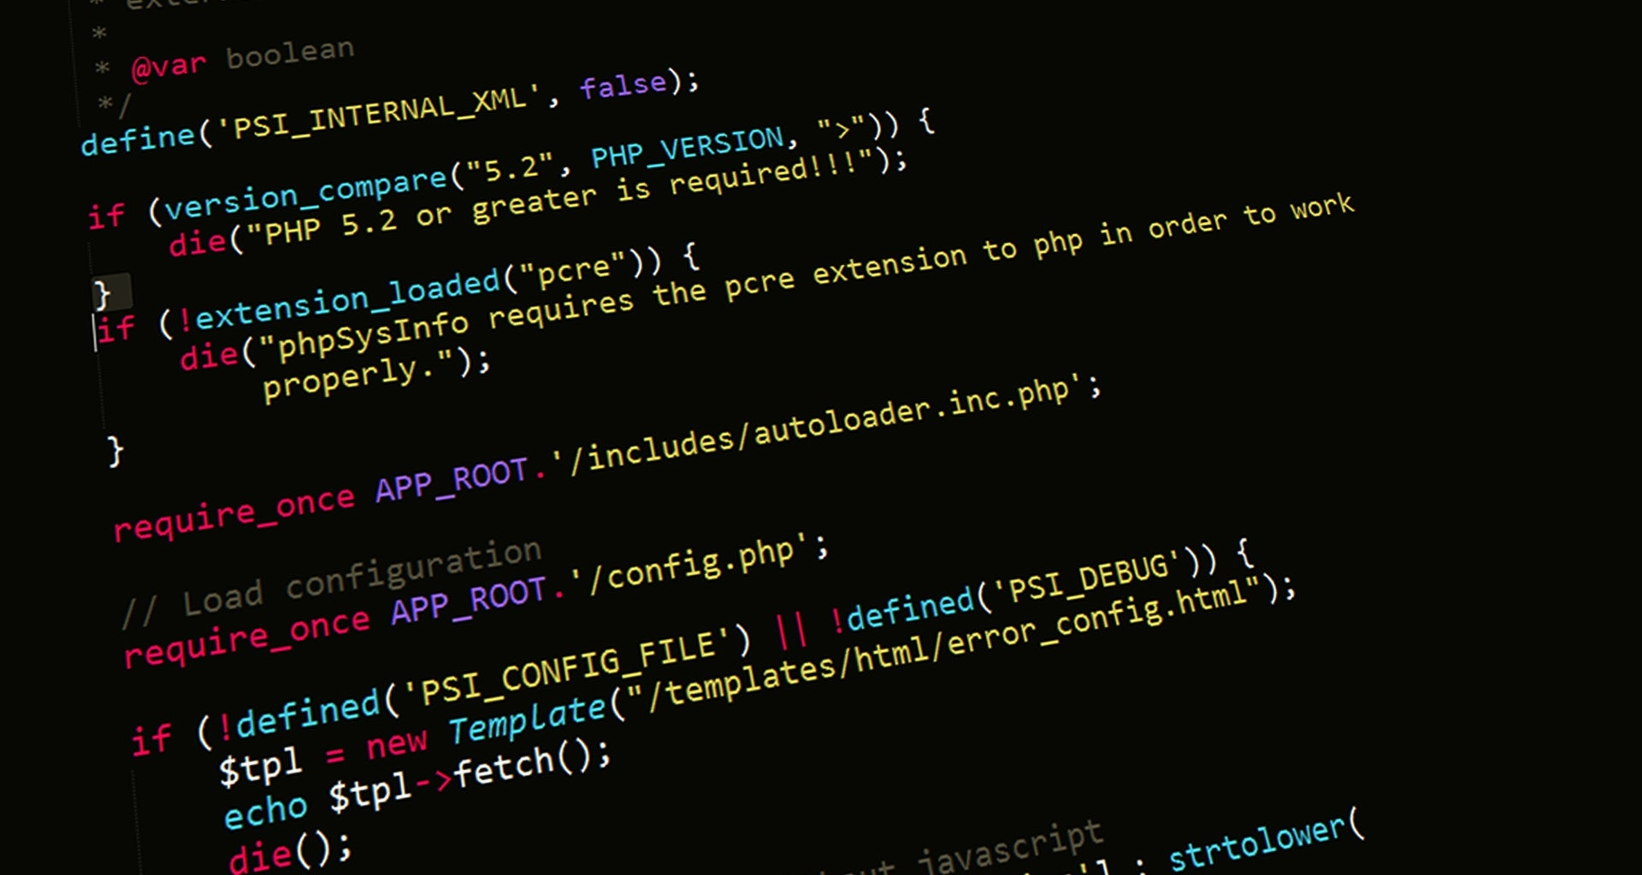
Assignment 2
CSCI 5308
Guturu Rama Mohan Vishnu (B00871849)

Slide 2
What is this presentation about?
This presentation depicts all the smells information of the open source project (greenDAO) I selected for Assignment 2, and it shows all the stats in the form of plots.

Slide 3
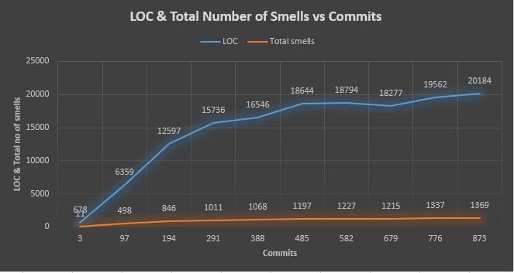
LOC & Total No of Smells vs Commits

Slide 4
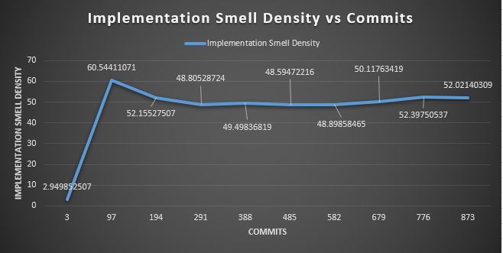
Implementation Smell Density vs Commits

Slide 5
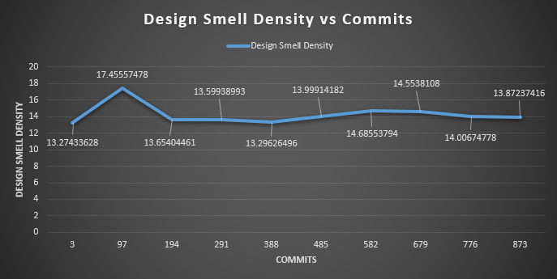
Design Smell Density vs Commits

Slide 6
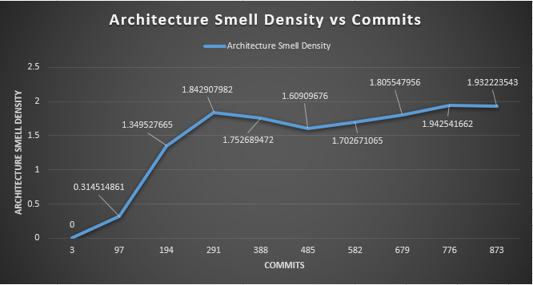
Architecture Smell Density vs Commits

Slide 7
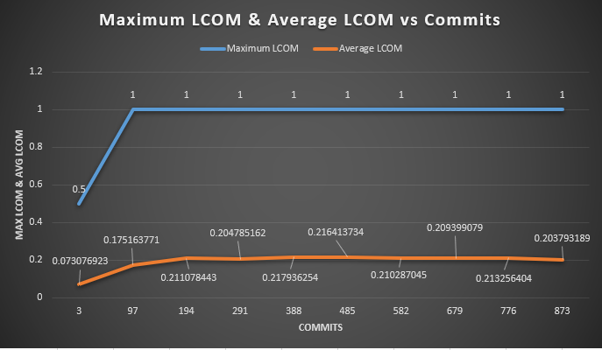
Maximum LCOM & Average LCOM vs Commits

Slide 8
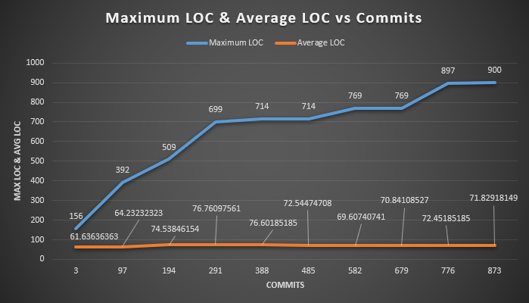
Maximum LOC & Average LOC vs Commits

Slide 9
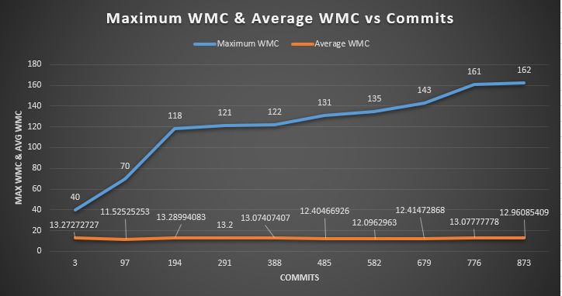
Maximum WMC & Average WMC vs Commits

Slide 10
Interesting Observations
As we can observe, the maximum Lines of Code (LOC) kept increasing as the commits kept on increasing but the average LOC remained almost constant but not exactly constant.
The average LCOM and maximum LCOM rose up suddenly between commit 1 and commit 2 but then after commit 2, both of these fields remained at the same level throughout the commits.
While the Design Smell Density and Implementation Smell Density had a similar pattern to Average LCOM and Maximum LCOM, Architecture Smell Density had different plans. It rose up on a high note until commit 4 from the starting point, but later on didn’t show much consistency in it’s rise.

Slide 11

Thank you!

